Slide 1
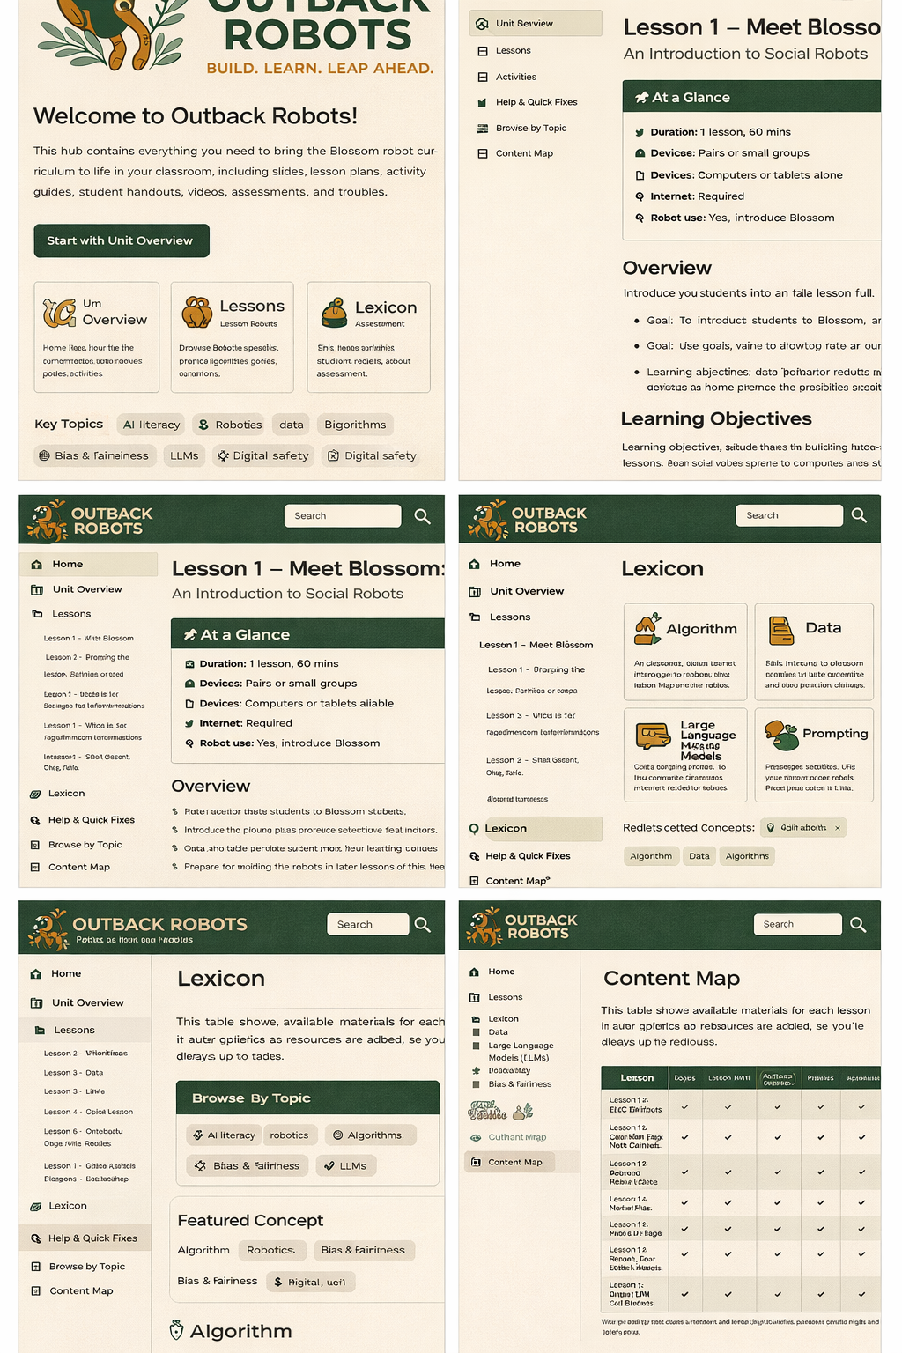
#FCF2E5
#425c47
# FDF8F1
#C68929

Slide 2



Slide 3



Slide 4


